Slide 1


St. David’s RC Primary School
RSE Curriculum

Slide 2

Our virtues…
Each half term we focus on 2 virtues that help us to grow in faith and values of the Gospel.
These values will be part of our vision within our RSE curriculum –
our relationships and treatment
of others.

Slide 3
The Curriculum for Wales – Relationships and Sexuality Education (RSE) Code.

Slide 4
Wales: RSE Code
What will primary children be taught?
https://www.youtube.com/watch?v=RG0XN4ccvWQ
Phase 1 learning objectives: from age 3
Phase 2 learning objectives: from age 7
Phase 3 learning objectives: from age 11

Slide 5
Relationships and Sexuality Education (RSE) Statutory Guidance and Code
RSE is intended to help children to develop healthy relationships and behaviours with their friends and families, based on kindness, empathy and respect. This is important for them to develop as ‘healthy, confident individuals’ with positive social, emotional and mental well-being.
Content will include learning about healthy relationships, keeping safe including online, and being confident to raise issues with a responsible adult.

Slide 6
Relationships and Sexuality Education (RSE) Statutory Guidance and Code
RSE will be a mandatory requirement in the Curriculum for Wales for all learners from age 3 to 16 (“the Act”). This means that all learners must receive this education. There is no right to withdraw from RSE in the new curriculum.
Our youngest learners will be taught about friendships and families, they will not be taught about romantic or sexual relationships: this is prohibited by the RSE Code. The law is clear: teaching of RSE must be developmentally appropriate for each and every child.

Slide 7

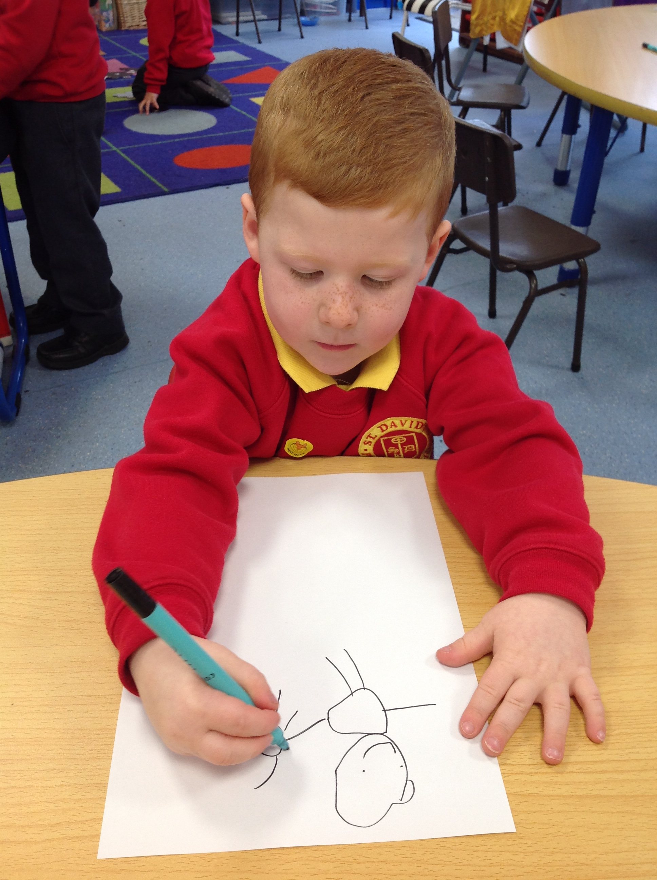
New Curriculum Areas of Learning and Experience…
Health & Well-Being
The Health and Well-being Area statements of What Matters provide detail on knowledge, skills and understanding related to RSE.
decisions and actions impact on others
personal care and hygiene
respect themselves and others

Slide 8

Rights of the Child…
UNCRC: The UN Convention on the Rights of the Child.
Article 12, ‘they have the right to have their views taken seriously’.
Article 16, ‘Every child has the right to privacy’.
Article 39, ‘children have the right to help if they have been badly treated’.
Article 36, ‘protect children from all forms of exploitation’.

Slide 9

Delivering RSE at St. David’s
A Fertile Heart assists children at various stages in their understanding and appreciation of the importance of their union with God through loving, respectful relationships'.
A Fertile Heart

Slide 10
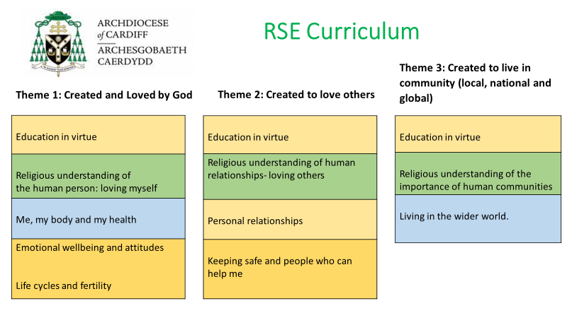
Delivering RSE at St. David’s
.

Slide 11



Delivering RSE at St. David’s
.
Theme 1: Created and Loved by God
Theme 2: Created to love others
Theme 3: Created to live in community

Slide 12
Delivering RSE at St. David’s
.
https://www.tentenresources.co.uk/life-to-the-full-primary/
The programme includes teaching about personal health, physical and emotional well-being, parts of the body, trusted adults, growing bodies, puberty, periods and the dangers of social media.
The entire teaching is underpinned with a Christian faith understanding that our deepest identity is as a child of God – created, chosen and loved by God. The programme is fully inclusive of all pupils and their families.
complexity of love, relationships and sexual health education in today’s world.

Slide 13
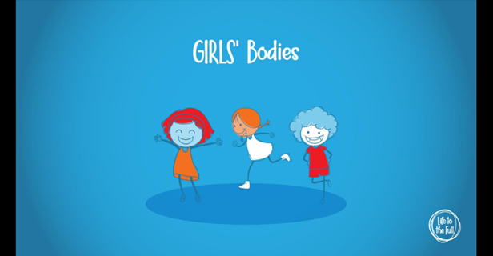
Delivering RSE at St. David’s
.
Years 5&6: Module 1
Session 2: Girls’ Bodies
thttps://www.tentenresources.co.uk/sessions/girls-bodies/
odd.

Slide 14

Delivering RSE at St. David’s
.
We will be using faith inspired resources, recommended by Cardiff Archdiocese to deliver our RSE curriculum. relationships and sexual health education in today’s world.

Slide 15
Contacts
.
Welsh Government: curriculumforwales@gov.wales
Fr Bernard Sixtus r.e@rcadc.org
(Director of Religious Education in Schools -Archdiocese of Cardiff)
y’s world.

Slide 16
St. David’s RC Primary School
RSE Curriculum
Thank you

