Slide 1

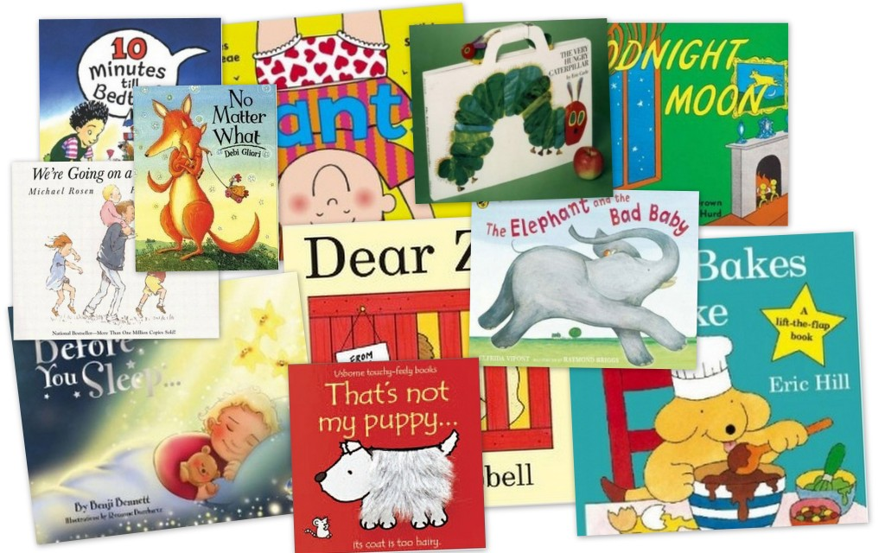
Reading
Cafe
Reception and Year 1

Slide 2
Reading in Reception and Y1:
Phonics
Shared reading
Group guided reading
Independent reading
Focused reading activities
Reading across the curriculum
Class stories and picture books.
Notes:
Give a brief overview of the function of each of the above aspects of treading in school.
Explain that all of these are part of the teaching of reading.
Explain that sometimes, as parents, there is an expectation that children are heard reading often. This may be the case for some, but not all children. The hearing of reading is not the same as the teaching of reading.
Explain the school policy and expectations about home reading – in general. Details to follow,

Slide 3
What does Phonics Mean?
Phonics is a way of teaching children how to read and write.
It helps children to hear, identify and use different sounds to build words and fluency as they read.
Understanding phonics will also help children know which letters to use when they are writing words.

Slide 4
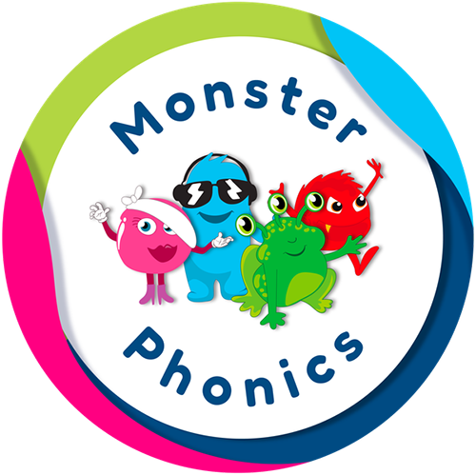
The teaching of phonics:
Black cat sounds
Blending
Monster vowel digraphs
Blending
Tricky Witch sounds
Blending
HF words
https://youtu.be/B5pWEBNL0zU

Slide 5
The teaching of phonics:
.
We introduce the new sound by pronouncing it correctly and asking the children to repeat it back.
We use a sound and pictures to familiarise the children with the sound.
We practise blending the sounds in words e.g. r-e-d; red/ r –oo-m; room
We write words with the new sound in.
We read the ‘HF words’ on sight.

Slide 6
The teaching of phonics:
Blending- blending helps us to read- put the sounds (phonemes) together to say the whole word, eg p-ar-k, park.
Segmenting- segmenting helps us to write and spell. Say the word and use fingers to break the word into sounds (graphemes)
HF words- these are words that are common or frequent in a text and cannot always be blended and sometimes need to be learnt on sight e.g. ‘the’ can’t be blended as it does not make sense.

Slide 7
Reading requires two skills:
Phonics and Word Recognition
The ability to recognise words presented in and out of context.
The ability to blend letter sounds (phonemes) together to read words.
Understanding (comprehension)
The ability to understand the meaning of the words and sentences in a text.
The ability to understand the ideas, information and themes in a text.
If a child understands what they hear, they will understand the same information when they read.

Slide 8
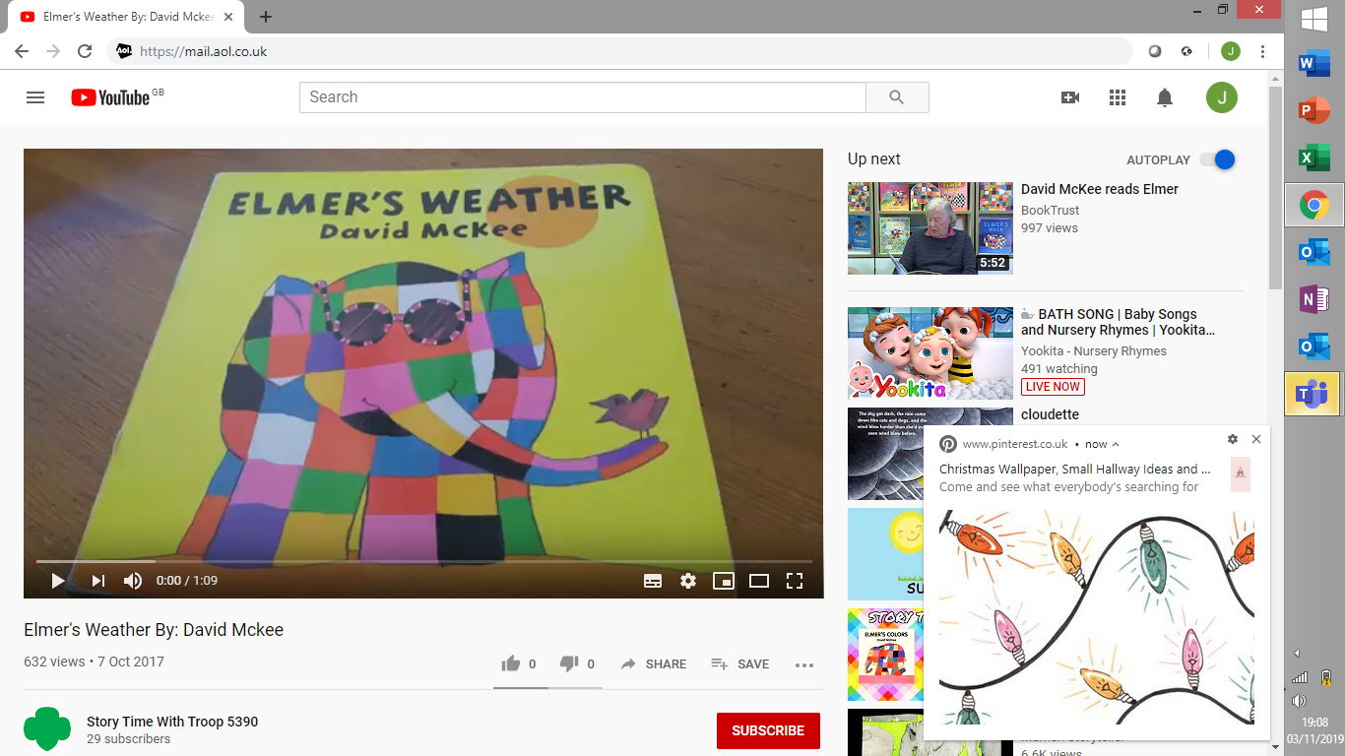
Predict
Predict what the story is going to be about.
What do you think will happen next?
Listen to the blurb. What do you think the story is about?

Slide 9
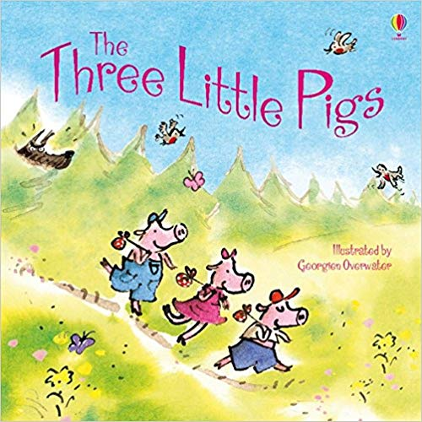
Explain
This week we have enjoyed reading ‘The Three Little Pigs’ in class.
What did you like most about the book?
Would you like to live in this setting?
Was there anything that you didn’t like about the book?
Who was your favourite character? Why?

Slide 10
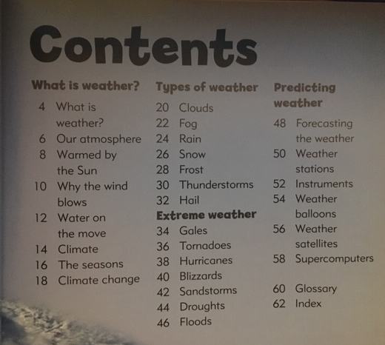
Retrieve
Why did Mummy pig tell the children they needed to build houses of their own?
They were too noisy
They were too big
They made too much mess
Who were the pigs afraid of?
What information would be find on page 46?
How did the rainbow become colourful again?

Slide 11
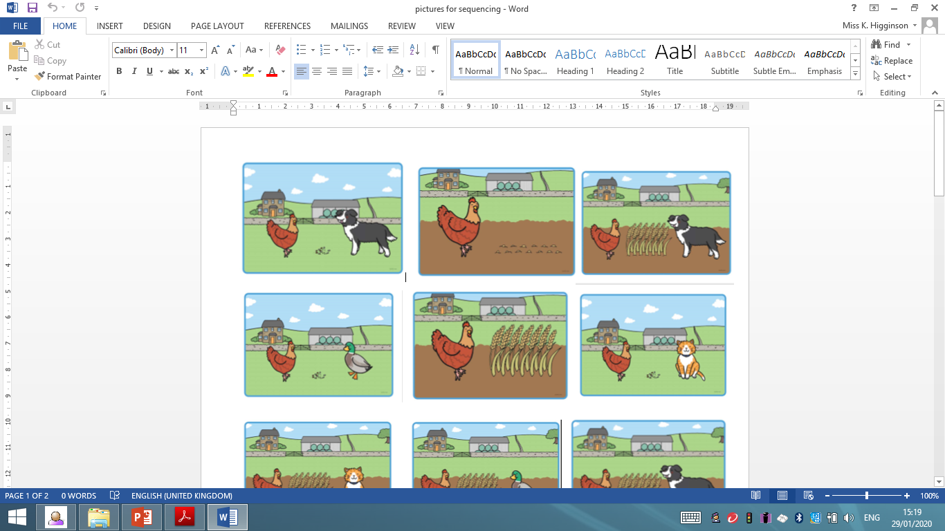
Sequence
Can you sequence the pictures?
What happens next?
What happened first?
What happened at the beginning, middle and end of the story?

Slide 12
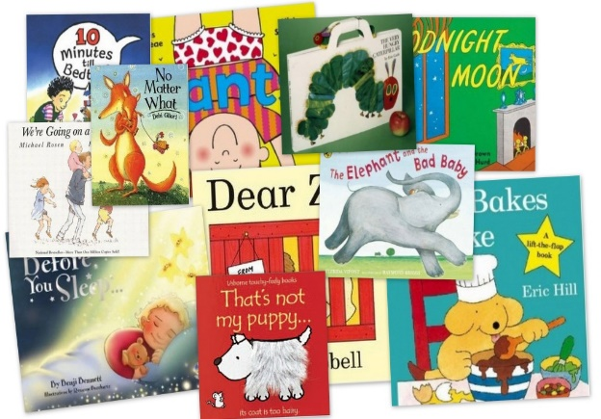
What to do if your child is stuck
Use phonics first. What sound does the word begin with? Can you say the sounds in the word? Blend them together.
Read to the end of the sentence. What would make sense?
Does it sound right?
Look at the picture. Does it help?
Notes:
Talk through each strategy and explain what each will do to help the child decode a word that they cannot read.
Independent Strategies
by Jill Marie Warner

Slide 13
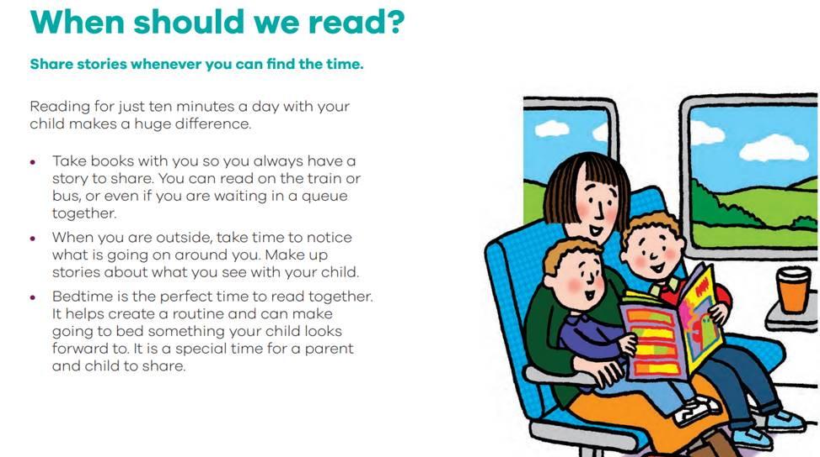
Reading with your child

Slide 14
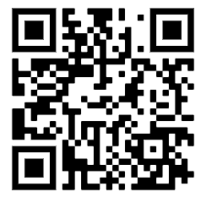
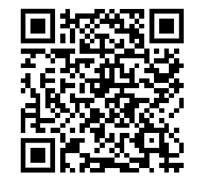
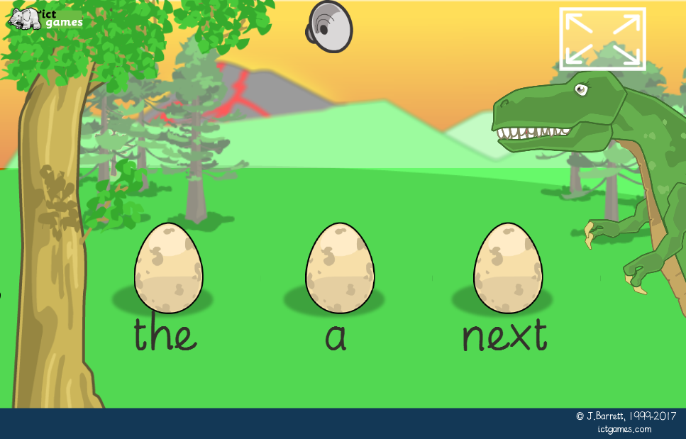

HF word games

Slide 15
Have fun!

